Slide 1
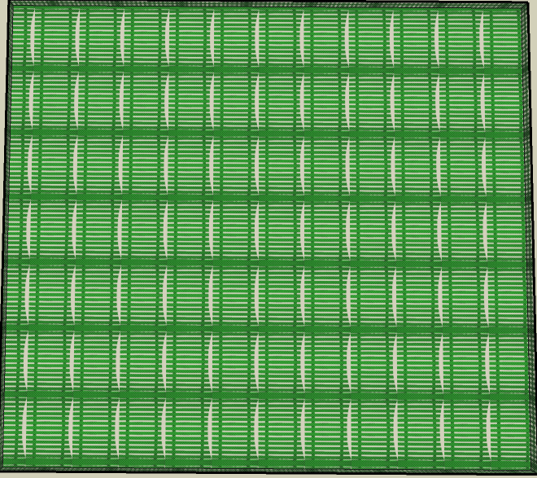

Slide 2
Area A
Area B
Area C
Area D

Slide 3



Area A

Slide 5
Area A
Fire monitoring

